Slide 1
Leukocytosis
By
Hussein Ali Naji

Slide 2
Leukocytosis
refers to an increase in the total number of WBCs due to any cause. From a practical standpoint, leukocytosis is traditionally classified according to the component of white cells that contribute to an increase in the total number of WBCs. Therefore, leukocytosis may be caused by an increase in (1) neutrophil count (ie, neutrophilia), (2) lymphocyte count (ie, lymphocytosis), (3) monocyte count (ie, monocytosis), (4) eosinophilic granulocyte count (ie, eosinophilia), (5) basophilic granulocyte count (ie, basophilia), or (6) immature cells (eg, blasts). A combination of any of the above may be involved.

Slide 3
Clinically, dividing leukocytosis on the basis of its causes is more convenient. By dividing it according to causes, leukocytosis can be immediately applied for diagnostic purposes. Leukocytosis can be caused by infection, inflammation, allergic reaction, malignancy, hereditary disorders, or other miscellaneous causes.

Slide 4
Morphology of Left Shifts
Mature segmented neutrophils and sometimes low numbers of band neutrophils are released from bone marrow into blood in normal animals. When increased numbers of nonsegmented neutrophilic cells are present in blood, their presence is referred to as a left shift.
Band neutrophils are commonly seen in blood, with meta­myelocytes and myelocytes present less often and promyelo­cytes and myeloblasts rarely encountered.

Slide 5
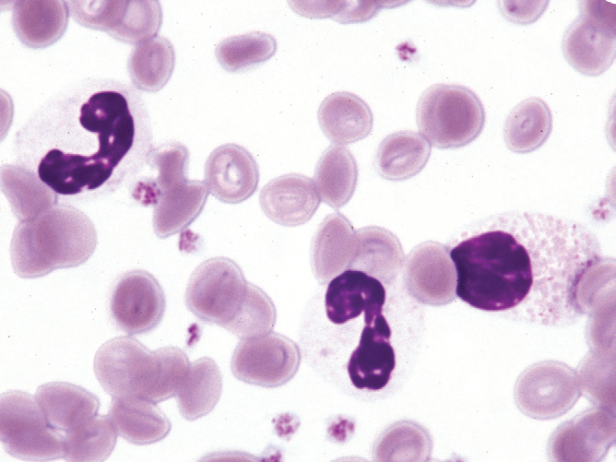
Band neutrophil (left), bilobed neutrophil (center), and eosinophilic myelocyte (right) in the blood of a cat with. Wright-Giemsa stain.

Slide 6
Disorders with Left Shifts
Left shifts are usually associated with inflammatory conditions. These conditions are often infectious but they may be noninfectious, as in immune-mediated disorders and infiltrative marrow disease. Left shifts are also present in animals with chronic myeloid leukemia.
When a left shift accompanies a neutrophilia in this way is known as a regenerative left shift and is a part normal response to acute infection, while the left shift the neutrophile numbers is normal or decreased called degenerative left shift.

Slide 7
Right shift (Hypersegmentation)
Hypersegmentation (right shift) has generally been defined as the presence of five or more distinct nuclear lobes within neutrophils of domestic animals. Hypersegmentation occurs as a normal aging process and may reflect prolonged transit time in blood, as can occur with resolving chronic inflammation, glucocorticoid administra­tion, or hyperadrenocorticism. Hypersegmentation may also be present in myeloid neoplasms.

Slide 8
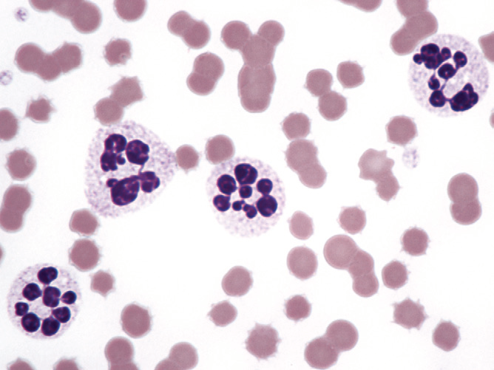

Slide 9
Neutrophilia
This term refers to an increase numbers neutrophiles in blood circulation, over about 10× 10⁹ in monogastric animals or about 4× 10⁹ in ruminant, this can occur in a numbers way.
1- A shift of cell from marginal pool to circulating pool, also called pseudo neutrophilia.
2. Steroid affect, in an acute steroid response there is an increase in circulating neutrophils .
3. Response to infection
4. Masked granulocytosis, refers to the situation which occur during mild infection.
5. Neoplasia. Myeloid/granulocytic leukaemia.

Slide 10
Eosinophilia
This term refers to an increase in the circulating numbers of Eosinophils in blood circulation, and higher count may be expected in sample taken at night. over about 1.0× 10⁹ , this can occur in a numbers way.
1- Eosinophilia may accompany parasitic diseases.
2- Eosinophilia may occur in association with eosinophilic inflammatory conditions of organs that normally contain numerous mast cells.
3- Eosinophilia has also been reported with sarcoptic mange and nasal mite infestations.
4- Eosinophilia has been reported in some hyperthyroid cats treated with methimazole or its prodrug carbimazole
5- Allergy and hypersensitivity reactions. 6-Mast cell tumours.
7- Oestrus. 8- Pregnancy/ recent parturition.

Slide 11
Basophilia
This term refers to an increase in the circulating numbers of Basophilia in blood circulation. over about 0.5× 10⁹ , this can occur in a numbers way.
1- Basophilia is generally associated with IgE-mediated disor­ders.
2- Basophilia may occur in some animals with mast cell tumors.
3- It has been reported in dogs with pulmonary lymphomatoid granulomatosis.
4- Basophilic leukemia must be differentiated from mast cell neoplasia with mastocytemia (sometimes called mast cell leukemia). Mast cells have round nuclei and baso­phils have segmented nuclei.

Slide 12
Monocytosis
This term refers to an increase in the circulating numbers of Basophilia in blood circulation. over about 0.5× 10⁹ , this can occur in a numbers way.
Monocytosis may occur in conditions that also cause neutro­philia.
It may be present in both acute and chronic inflammation.
Endogenous and exogenous glucocorticoid steroids can induce monocytosis in animals, especially in dogs.
Monocytosis occurs in animals with acute monocytic or acute myelomonocytic leukemias.
Normal domestic animals may have few or no monocytes in blood; consequently the term monocytopenia is not usually used.

Slide 13
Lymphocytosis
This term refers to an increase numbers neutrophiles in blood circulation, over about 6× 10⁹ in monogastric animals or about 9× 10⁹ in ruminant, this can occur in a numbers way.
1- Lymphocyte numbers in blood vary with age.
2- Transient lymphocyto­sis sometimes occurs with excitement or exercise in animals (especially horses and cats).
3- Lymphocytosis is sometimes present in animals with low-grade or chronic inflammatory conditions.
4- Bacterial diseases that may sometimes have an associated lymphocytosis.
5-Viral diseases that may sometimes have an associated lym­phocytosis include (Feline Leukemia virus) FeLV infection in cats, caprine arthritis-encephalitis virus infections in goats, and bovine leukemia virus (BLV) infection in cattle and sheep.

